Slide 1
COMP 3006 – Software Engineering
Stock Monitoring System
404 NOT FOUND
12210102 MAK KIT TIN
15208249 LEUNG KAI HIN
13205633 CHAN WING SUN
13207296 YEUNG MAN KIT
Notes:
This template can be used as a starter file for a photo album.

Slide 2
Stock monitoring system
Introduction

Slide 3
What is Stock Monitoring System
Serve individual investors
Real-time stock information
Track list.
Stock price tracking
display real-time stock market situation
Changes by alerting users automatically
Users can aware of the changes of their target stocks during the daily life.

Slide 4
What is Stock Monitoring System
Notification
Get notified when stocks reach target price ranges
Personal watch lists and profit calculator
manage target stocks
in the organized and clear interface.

Slide 5
Why do we need to develop this system
Problems of software in the market:
Information not up to date
Data not sync
Not user friendly
Poor security
Price issue

Slide 6
Difficulties of the system
API for stock information
Auto-refresh 20 stocks at the same time without system failure
System is developed by using python
Time issue

Slide 7
How to overcome the difficulties
Using free API
Multi-threading/processing technology
Using free GUI-framework to develop the program
Using existing libraries

Slide 8
Functions of the Program
User Management System
Register
Login*
Logout*
Setting
News Display System
Display news related to HK stock market*
Stock Searching Engine
Search stock real-time information*

Slide 9
Functions of the Program
Stock Monitoring System
Stock price tracking*
Notification System
Notification for custom stock conditions.
Administration System
Modify user information
Member authorization
System statistics

Slide 10
Stock monitoring system
System Overview

Slide 11
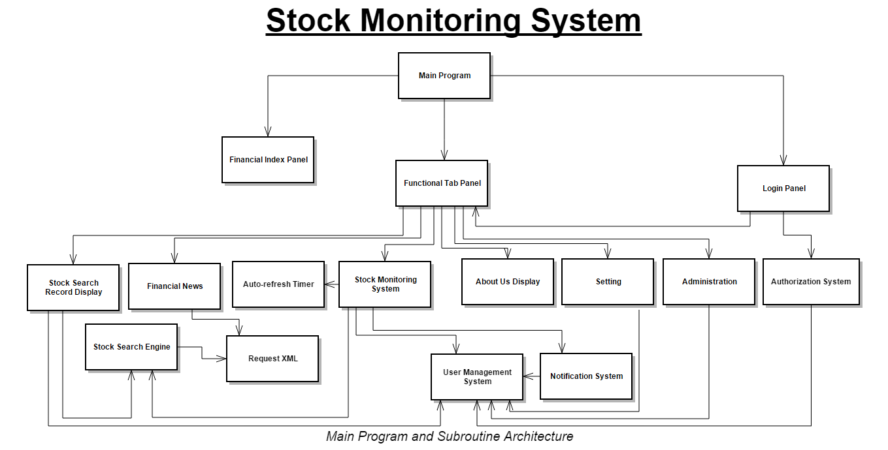
Notes:
System Design

Slide 12
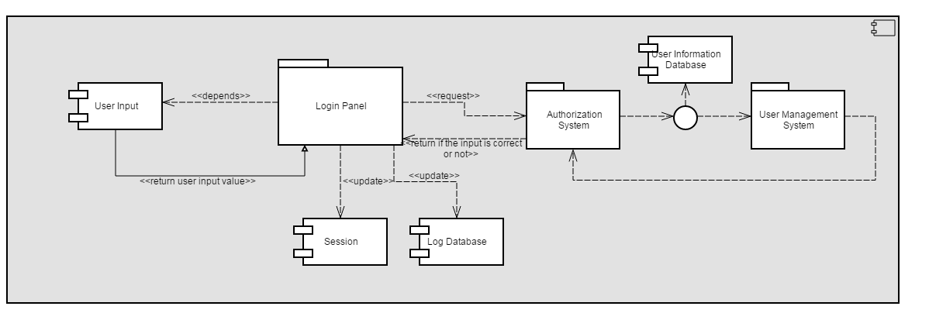
Notes:
Login Process – Component Design

Slide 13
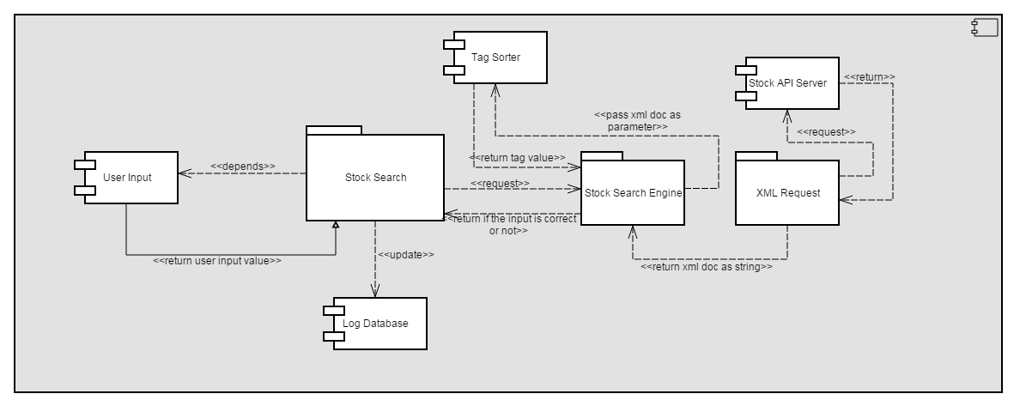
Notes:
Stock Search Engine– Component Design

Slide 14
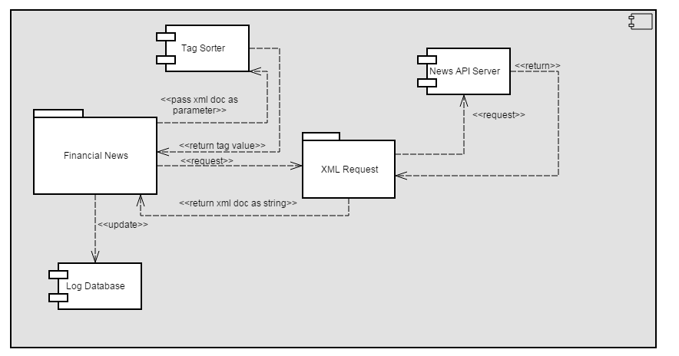
Notes:
Financial News– Component Design

Slide 15
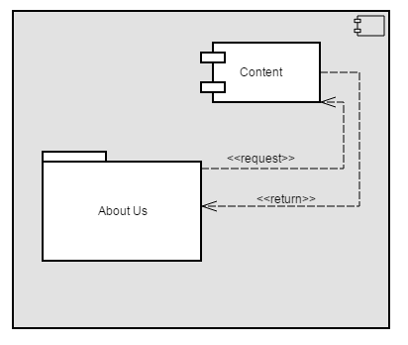
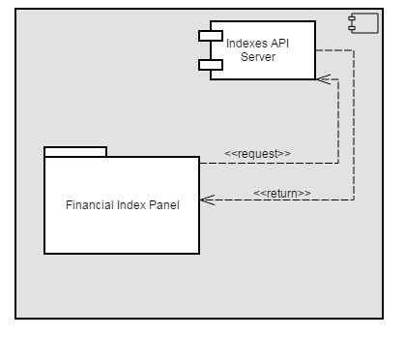
Notes:
About Us & Indexes– Component Design

Slide 16
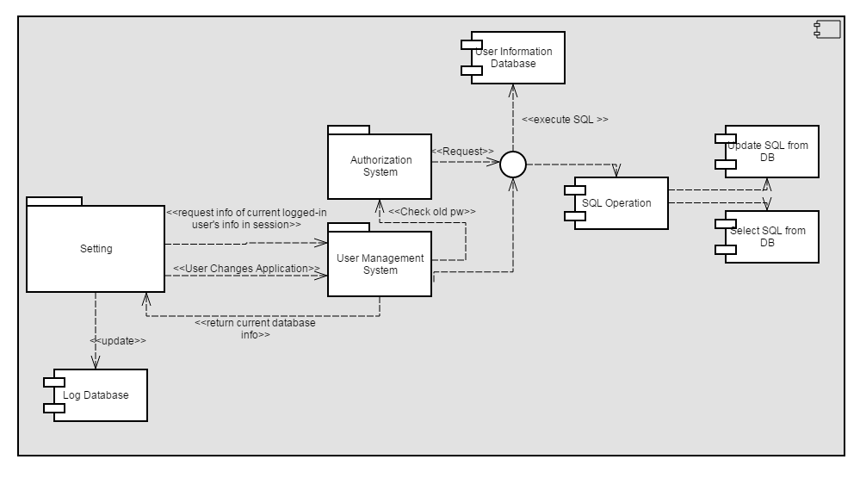
Notes:
Setting– Component Design

Slide 17
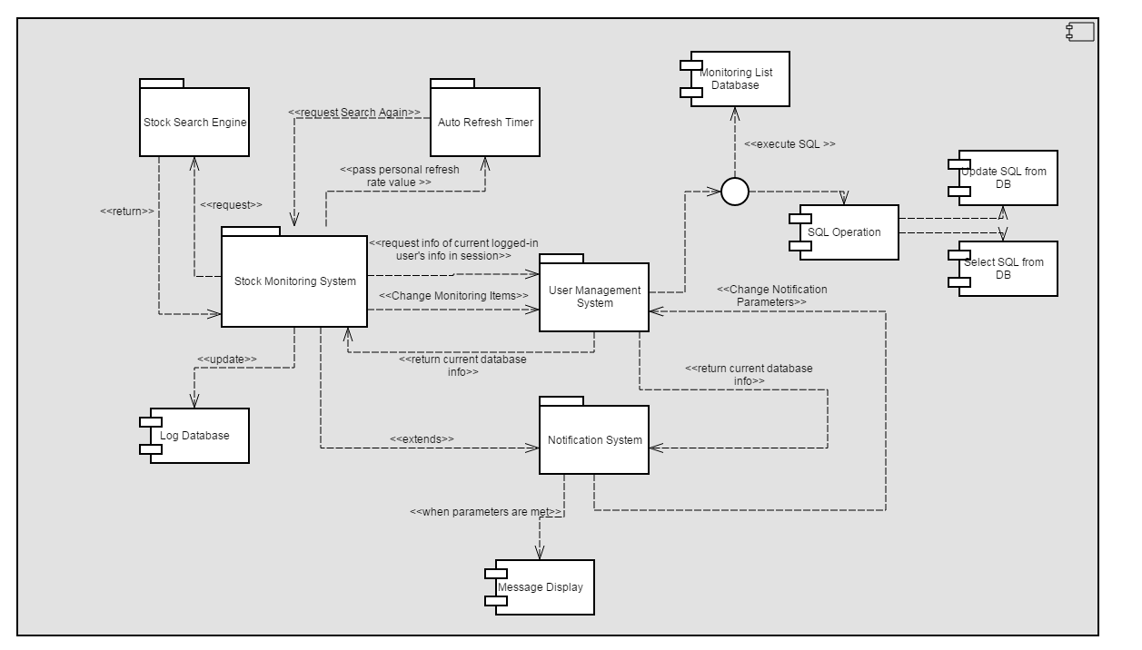
Notes:
Monitoring System + Notification– Component Design

Slide 18
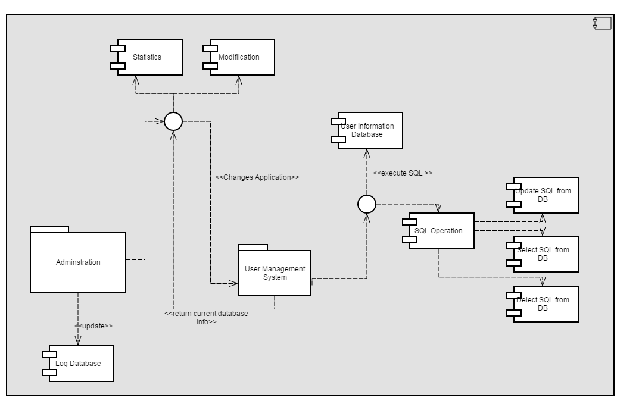
Notes:
Adminstration– Component Design

Slide 19
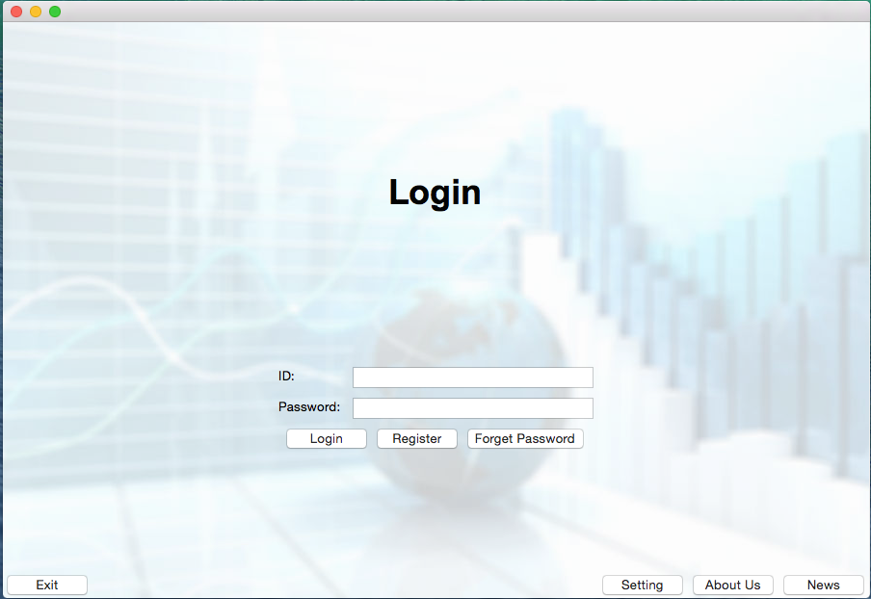
Notes:
UI – MemberMangagementSystem_HomePage

Slide 20
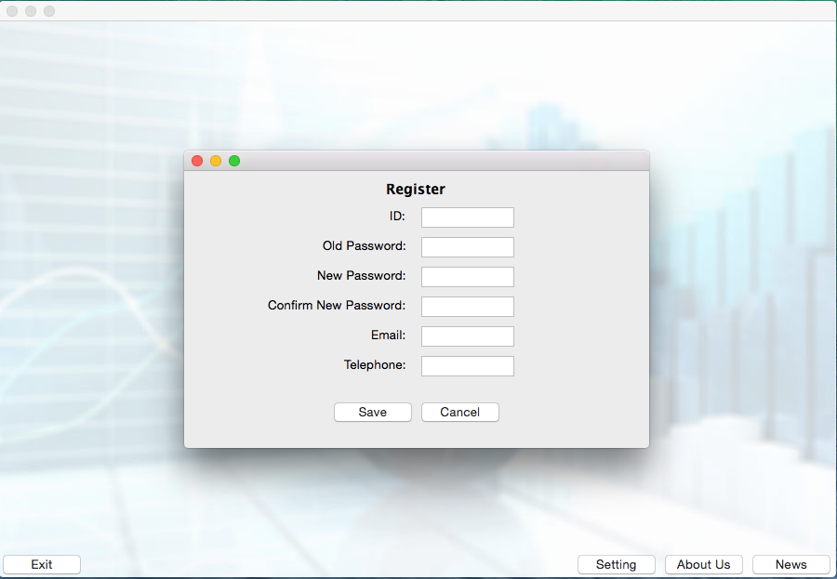
Notes:
UI - MemberMangagementSystem_Register

Slide 21
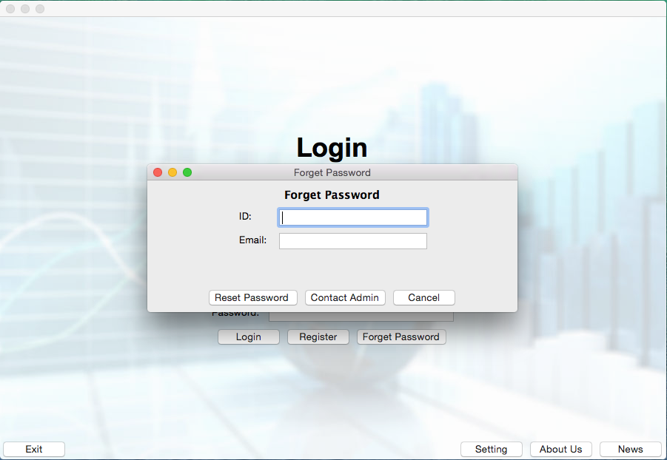
Notes:
UI – Forget PW

Slide 22
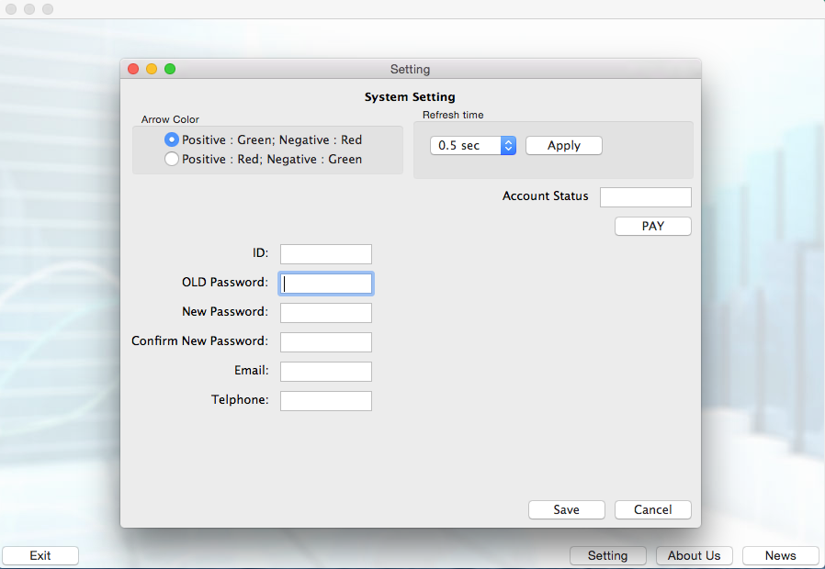
Notes:
UI - MemberMangagementSystem_Setting

Slide 23
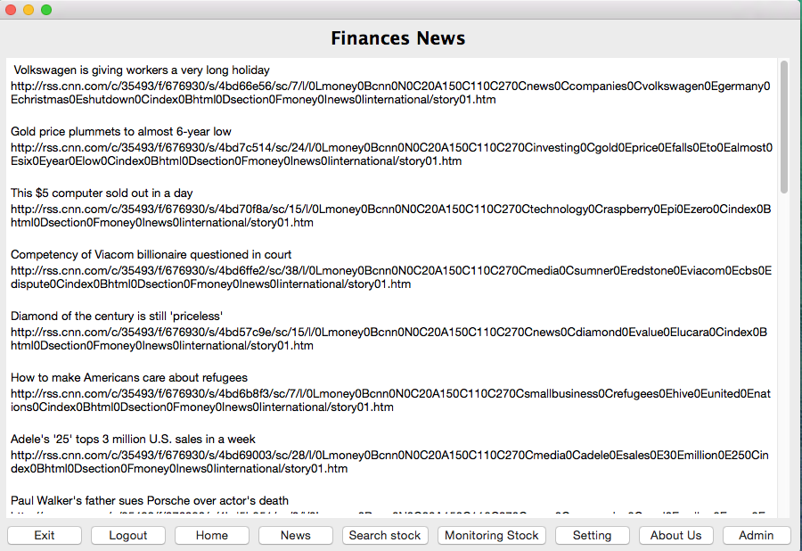
Notes:
UI - NewsDisplay

Slide 24
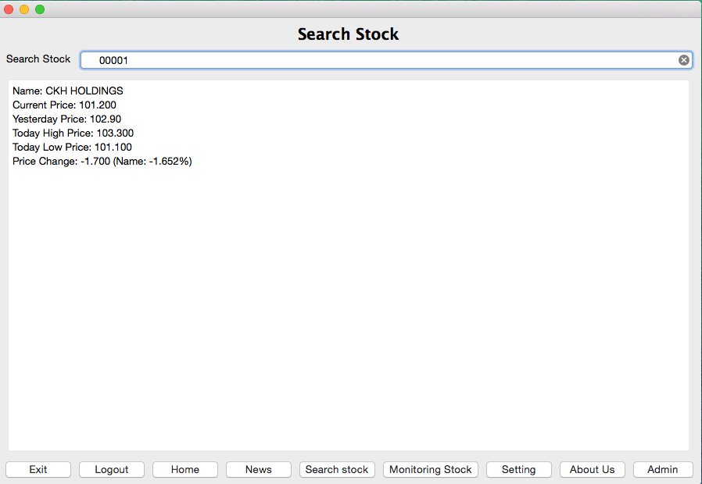
Notes:
UI - StockSearchEngine

Slide 25
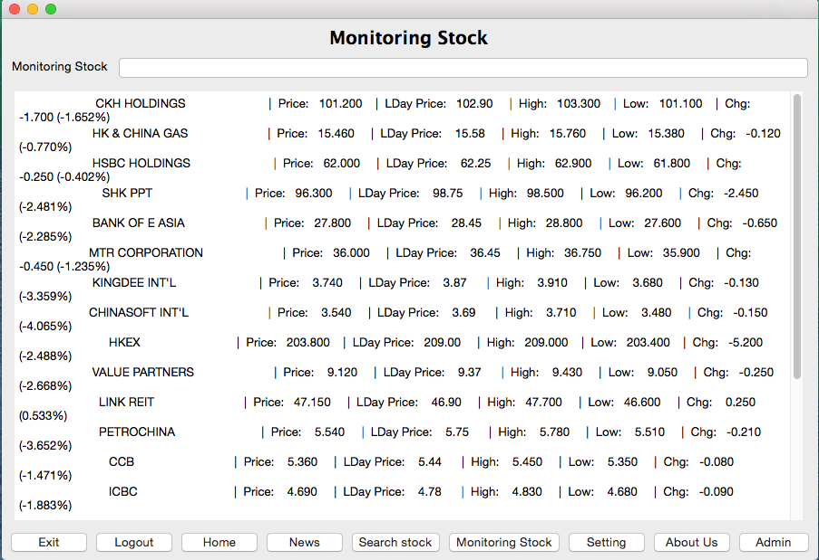
Notes:
UI - StockMonitoring

Slide 26
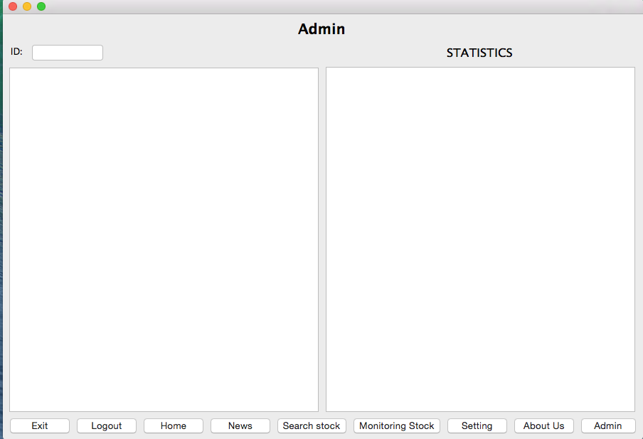
Notes:
UI - Admin

Slide 27
Notes:
UI – About Us

Slide 28
Stock monitoring system
Demonstration

Slide 29
Stock monitoring system
Future Development

Slide 30
Future development
GUI enhancement
Multi-processing/threading enhancement
Complete Functions Development
Multi-language platforms
System Security
Multi-Platform Compatible
Object Oriented Programming Enhancement

Slide 31

Q&A TIME

Slide 32
Thank You !

